Slide 1

AirAware – AI Based Air Quality Management System
Web-Based Air Quality Awareness Platform
Notes:
1

Slide 2
Presented by :-
Patel Het Dineshbhai | 23BECE30200 | Div-C
Jansari Jigar Lalitbhai | 23BECE30088 | Div-B
Patel Dhruvil Hareshkumar | 23BECE30180 | Div-C
Patel Aryan Mahendrabhai | 23BECE30167 | Div-C
Guided By :-
Prof. Jaiminee Patel
Notes:
2

Slide 3

PROBLEM STATEMENT
The Air Quality Challenge in India
Air pollution has emerged as a critical public health crisis in India, with millions exposed to hazardous air quality daily. Despite the availability of Air Quality Index (AQI) data, most citizens struggle to interpret these numbers and understand their health implications.
The core challenges include:
Complex AQI metrics that lack context for general users
Absence of personalized health guidance and protective recommendations
Limited accessibility for diverse user groups
Gap between data availability and actionable awareness
Notes:
2

Slide 4
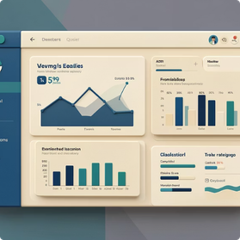
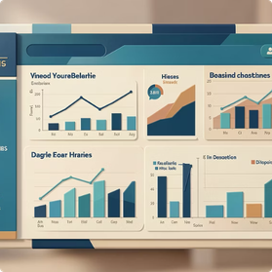
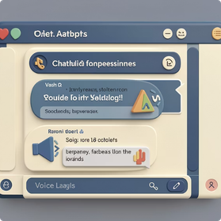
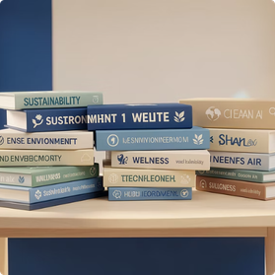
PROJECT OVERVIEW
Bridging Data and Understanding
Awareness-Focused Platform
Interactive Dashboard
Smart Assistance
Educational Content
Real-time AQI visualization with city wise data, color-coded indicators, and comprehensive pollutant breakdowns.
AI-powered chatbot for guided queries and voice-based alerts ensure accessibility and immediate health guidance.
Curated blog module delivering evidence-based articles on air quality impacts, prevention strategies, and environmental awareness.
AIR AWARE transforms complex air quality data into accessible, meaningful insights for everyday users through an intuitive web-based interface.
Notes:
3

Slide 5
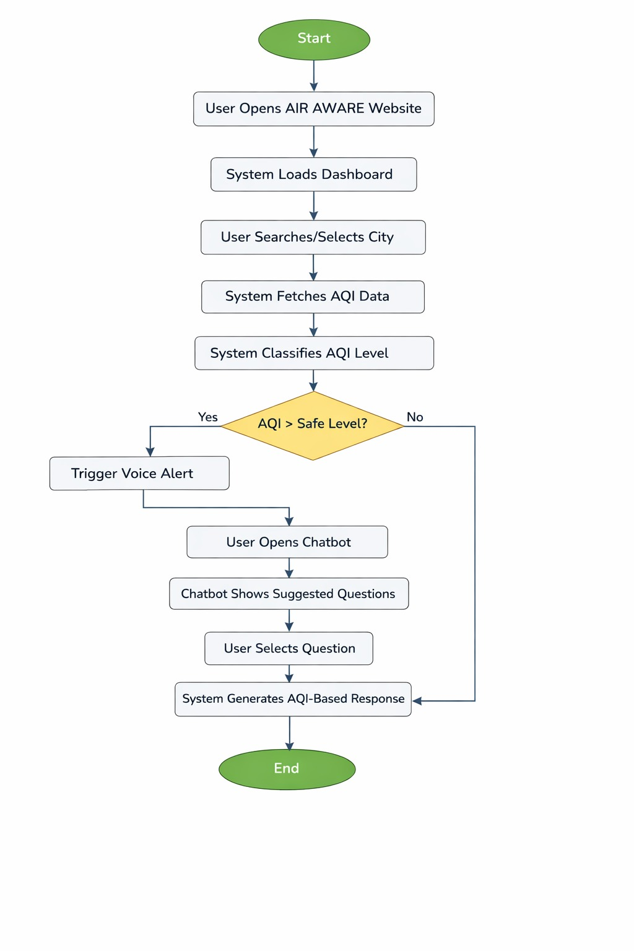
Activity Diagram :

Slide 6
Goals & Objectives
Core Mission
Comprehensive Coverage
Visual Clarity
Transform air quality data into actionable awareness that empowers individuals to make informed health decisions and contribute to environmental consciousness.
Intuitive color-coded representations and charts
City wise AQI monitoring across India
Our platform bridges the gap between technical metrics and public understanding through intelligent assistance and educational resources.
Health Guidance
Personalized safety recommendations based on AQI levels
Notes:
5

Slide 7





Target User Groups
General Public
Students & Educators
Health-Conscious Individuals
Everyday citizens seeking to understand local air quality and protect their families from pollution exposure.
Academic communities using the platform for environmental education, research projects, and classroom learning.
People with respiratory conditions, athletes, and outdoor enthusiasts who need reliable air quality information for activity planning.
Environmental Organizations
Academic Evaluators
NGOs and advocacy groups leveraging data-driven insights to support awareness campaigns and policy initiatives.
Faculty and reviewers assessing the technical implementation, user experience design, and societal impact of the platform.
Notes:
6

Slide 8

ARCHITECTURE
Technology Stack Structure
Data Layer
JSON storage format
Backend Layer
Python Flask API
Visualization Layer
Chart.js graphs and charts
Frontend Layer
HTML/CSS/JavaScript UI
User Layer
Web Browser interface
Notes:
4

Slide 9

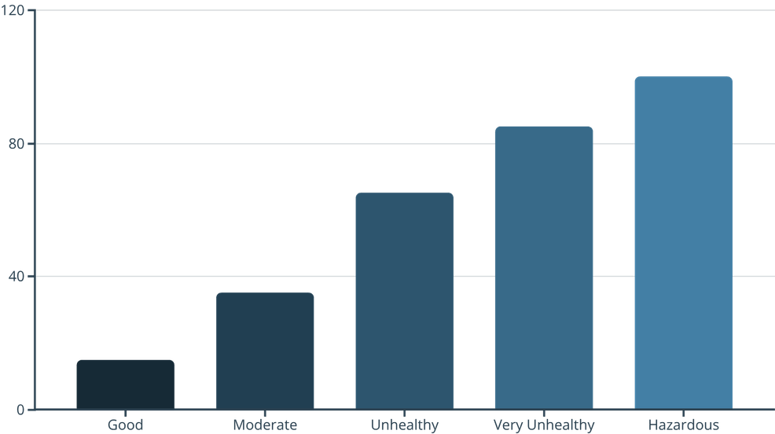
DASHBOARD
AQI Dashboard & Data Representation
Intelligent Data Visualization
The dashboard provides comprehensive air quality insights through multiple visualization layers, making complex environmental data instantly understandable.
Sample AQI category distribution showing relative health impact severity across standard classification ranges.
Geographic Search
Color-Coded Indicators
Pollutant Breakdown
Interactive Charts
City wise AQI lookup with autocomplete functionality for quick access to local data
Standardized AQI color scheme (green to maroon) instantly communicates air quality severity levels
Detailed PM2.5 and PM10 measurements with trend analysis and historical comparisons
Dynamic Chart.js visualizations with animated transitions revealing temporal patterns and pollutant distributions
Notes:
7

Slide 10






Chatbot & Voice Alert Features
Guided Dashboard Assistant
Interactive chatbot navigates users through AQI features, explains metrics, and answers air quality questions in conversational language.
Flexible Query System
Supports both predefined quick queries (current AQI, health tips) and free-text natural language questions for comprehensive assistance.
Explainable Responses
Rule-based logic ensures transparent, accurate answers with clear reasoning behind health recommendations and safety guidelines.
Voice Alerts
Audio notifications warn users of hazardous AQI levels, improving accessibility for visually impaired users and enabling hands-free operation.
Notes:
8

Slide 11


EDUCATION
News & Blog Module
Knowledge Hub for Air Quality Awareness
The blog module serves as a comprehensive educational resource, translating scientific research into actionable insights for diverse audiences.
AQI Fundamentals: Clear explanations of pollutants, measurement standards, and index calculations
Health Impact Analysis: Evidence-based articles on respiratory effects, cardiovascular risks, and vulnerable populations
Prevention Strategies: Practical guidance on air purifiers, masks, indoor air quality, and lifestyle adjustments
Environmental Education: Policy updates, emission sources, and community action opportunities
Content is regularly updated with peer-reviewed sources and written for accessibility across education levels.
Notes:
9

Slide 12
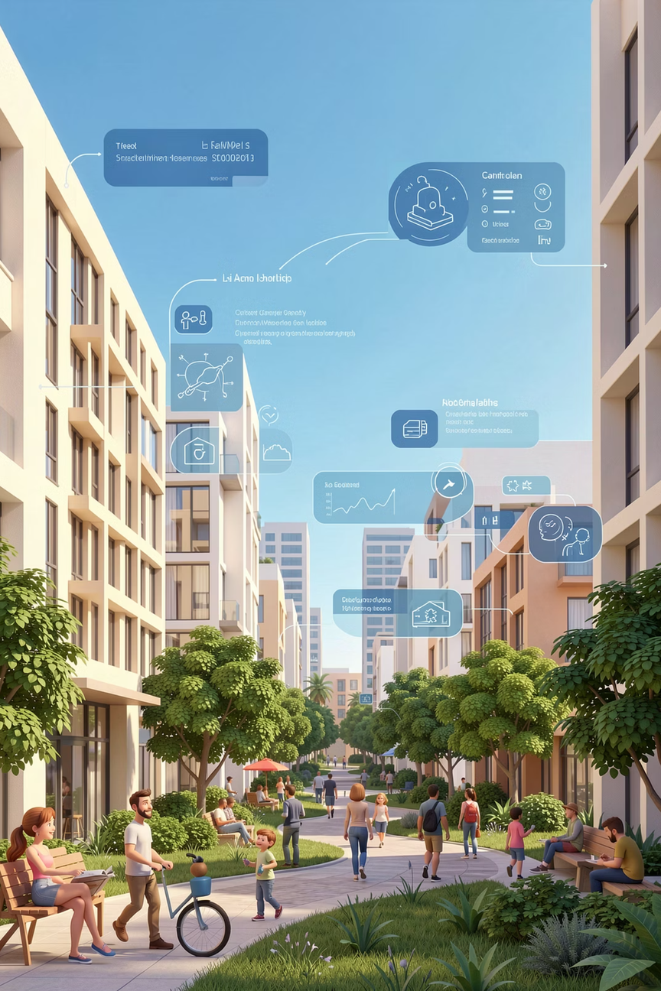
Conclusion:
Empowering healthier communities through intelligent air quality awareness.
Bridging the Data-Knowledge Gap
Promoting Proactive Health & Safety
Transforms complex AQI metrics into clear, accessible insights tailored for diverse Indian communities.
Delivers personalized health guidance, enabling citizens to make informed decisions and protect their well-being.
Fostering Environmental Stewardship
Elevates public awareness, inspiring collective action and advocacy for a cleaner, greener future.
The AIR AWARE platform is more than just a dashboard; it's a vital tool in India's journey towards environmental consciousness. By providing intelligent, actionable insights, it drives proactive health management and inspires collective action for a sustainable tomorrow.
Notes:
11

Slide 13
Thank You

